Slide 1
Memory Systems Design
  Introduction: 2 Lectures
    Classification of Memory Technology
    Expanding Memory Width and Size
    Memory and CPU Interfacing
  Address Decoding: 3 Lectures
    Full Address Decoding Techniques
    Partial Address Decoding Techniques
    Block Address Decoding Techniques
Note there are some example memory address decoder problems on Canvas
©Paul Davies. Not to be copied, used, or revised without explicit written permission from the copyright owner.
This lecture may contain animations and is best viewed as a slide show

Slide 2
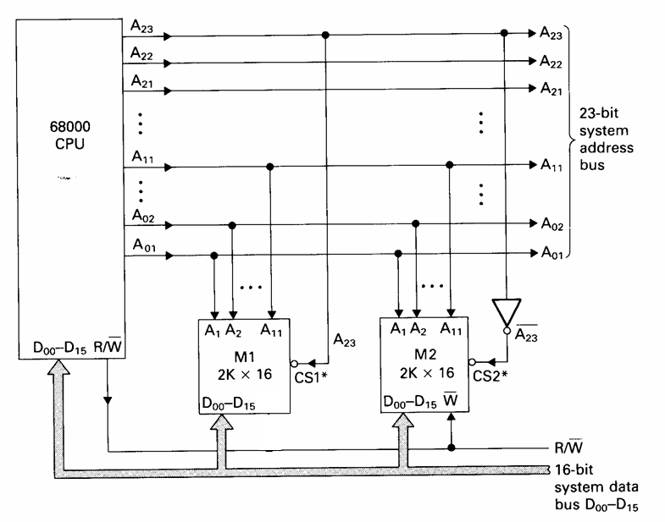
Partial Address Decoding
Here only a minimal sub-set of unused address lines feed the decoder circuit.
Partial decoding can lead to a reduction in
  Complexity of decoder (fewer gates)
  Propagation delay of the decoder
  Power consumption (fewer gates)
  PCB/chip “real-estate” and cost
Partial address decoders are particularly attractive when used with CPUs having a large address space i.e. 32/64 bit address
Going back to our very 1st example of a memory system, (Lecture 3) we could design a simple partial address decoder for a system with 2K words of Rom and Ram like this.
With only two blocks to decode (Rom + Ram) we should only need to decode 1 address line e.g. A23 could be used
Rom
Ram
Note it’s typical in partial decoding schemes to use the most significant or upper address lines to form the subset
We could arrange for M1 (Rom) to be enabled when A23 = 0 and M2 (Ram) to be enabled when A23 = 1 thus both devices can never be selected at the same time. It also means there is still ROM located at address 0 (a requirement for the 68000).

Slide 3
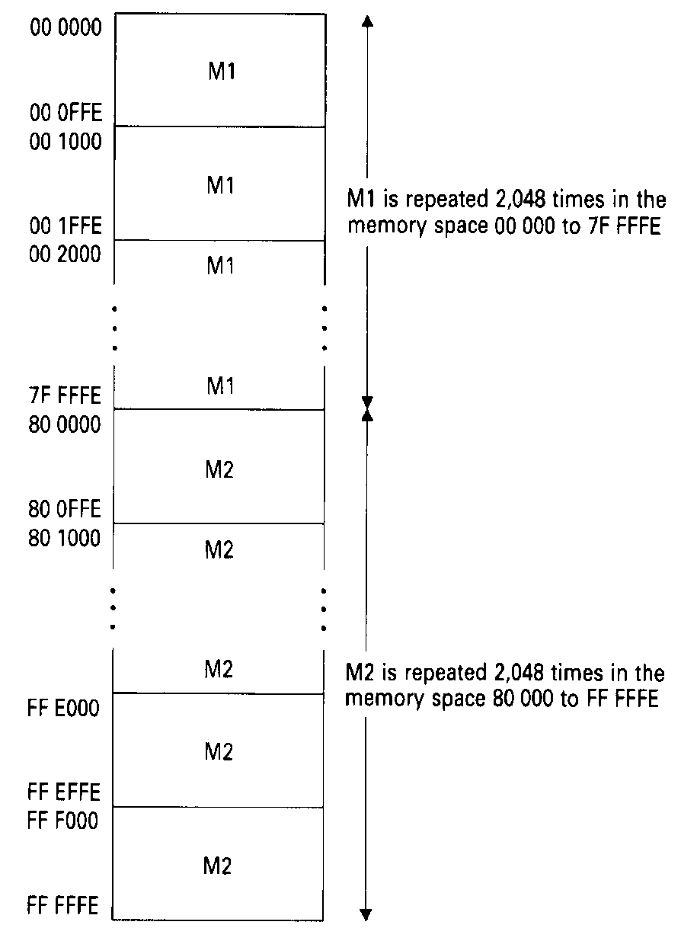
However, there are drawbacks to partial decoding, for example take the circuit just considered.
Because only A23 was used by the address decoder, the other 11 address lines (A22 - A12) play no part in the decoding process and thus act as ‘don’t cares’ to the decoder.
The effect of this is that both 2k word memory blocks get ‘mirrored’, in the memory map.
That is, each block appears to the CPU to be replicated 2048 times and appears as 4M words. This is because A22 – A12 plays no part (i.e. 11 address lines) and 2¹¹ = 2048
This would certainly confuse a booting operating system searching for installed memory.
Here the OS might conclude that the system has 8M bytes of Ram instead of the 4K bytes it really has which is devastating to say the least.
M1 selected for ALL addresses where A23 = 0
00 0000
00 0FFF
00 1000
M1 is repeated 2048 times in the memory space 00 0000 to 7F FFFF
00 1FFF
00 2000
7F FFFF
M2 selected for ALL addresses where A23 = 1
80 0000
80 0FFF
80 1000
M2 is repeated 2048 times in the memory space 80 0000 to FF FFFF
FF E000
FF EFFF
FF F000
FF FFFF

Slide 4
Partial Decoding: A more practical example
Let’s go back to the problem of the simple Rom, Ram and Peripheral mapping problem from lecture 3. That system comprised of the following
  10K words of Rom arranged as
    A block of 2K (Rom1) plus
    A block of 8K (Rom2)
  2K words of Ram (Ram1)
  2 individual words for Peripheral 1 (Peri1)
  2 individual words for Peripheral 2 (Peri2)
The address table for a FULL address decoder scheme is repeated below for the sake of comparison and uses many gates to fully decode all unused address lines. Let’s look at a partial decoding scheme.
Address 23 22 21 20 19 18 17 16 15 14 13 12 11 10 9 8 7 6 5 4 3 2 1
0 0 0 0 0 0 0 0 0 0 0 0 x x x x x x x x x x x Rom1
0 0 0 0 0 0 0 0 0 0 0 1 x x x x x x x x x x x Ram1
0 0 0 0 0 0 0 0 0 1 x x x x x x x x x x x x x Rom2
0 0 0 0 0 0 0 0 1 0 0 0 0 0 0 0 0 0 0 0 0 0 x Peri1
0 0 0 0 0 0 0 0 1 0 0 0 0 0 0 0 0 0 0 0 0 1 x Peri2
000000-000FFF
001000-001FFF
004000-007FFF
008000-008003
008004-008007

Slide 5
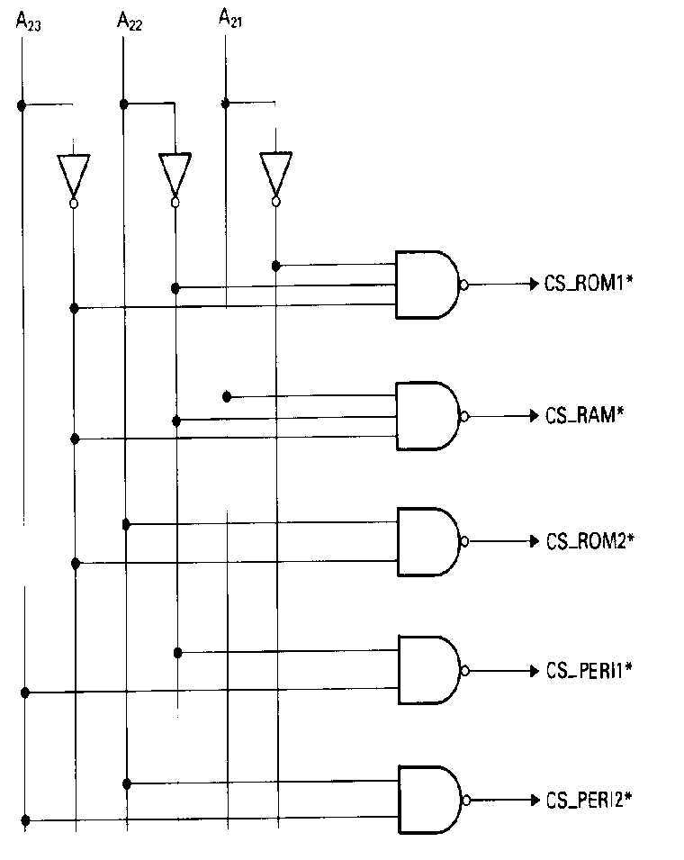
Solution using Partial Decoding
With 5 chip select signals to produce, in theory only 3 address lines should be needed by our partial decoder (2³ > 5).
One possible address table for a simple memory map is illustrated below where only the 3 highest address lines are decoded.
(Note: this address map is different to the original full address decoder from lecture 3 as it has been chosen to maximise the advantages of partial address decoding, however Rom1 is still at address 0, but other address may have changed).
Question: What is the address range and size (including mirroring) of each block?
Logic Equations
Rom1 CS* = !(!A23 . !A22 . !A21)
Ram1 CS* = !(!A23 . !A22 . A21)
Rom2 CS* = !(!A23 . A22)
Peri1 CS* = !( A23 . !A22)
Peri1 CS* = !( A23 . A22)
Address 23 22 21 20 19 18 17 16 15 14 13 12 11 10 9 8 7 6 5 4 3 2 1
0 0 0 x x x x x x x x x x x Rom1
0 0 1 x x x x x x x x x x x Ram
0 1 X x x x x x x x x x x x x x Rom2
1 0 X x Peri1
1 1 X x Peri2
ignored
ignored
ignored
ignored
ignored

Slide 6
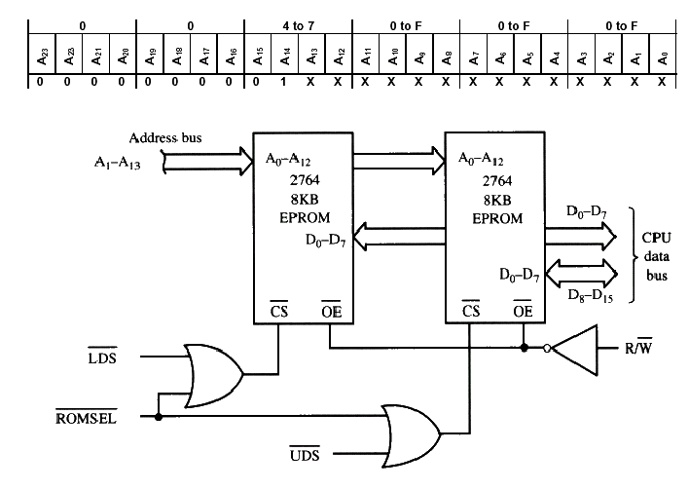
Exercise 11
Design a Partial address decoder for a 68000 based system with 8K Words of EPROM space, so that it responds to a base address of $00 8000, using 8K byte memory chips.
Solution 11
Two chips are needed for 8k x 16. Each chip will use 13 address lines, (2¹³ = 8192) a0-a12 connected to A1-A13 on the CPU leaving potentially A14-A23 to feed the decoder.
A base address of $00 8000 = [0000,0000,10xx,xxxx,xxxx,xxxx], when A15 = logic 1
An address table is given below, along with a sample circuit.
As a minimum solution, A15 could be used as our ROMSEL signal as this would mean the device definitely responds to address $00 8000 but also lots of other addresses due to mirroring.
We could reduce the mirroring and at the same time free up space in the memory map for future memory expansion, if we also included A23-A20 = 0 into the decoding logic. This ensures the ROM would still respond to the base address required.
Address 23 22 21 20 19 18 17 16 15 14 13 12 11 10 9 8 7 6 5 4 3 2 1
0 0 0 0 x x x x 1 x x x x x x x x x x x x x x Rom
Logic Equations
ROMSEL = !(!A23 . !A22 . !A21 . !A20 . A15)

Slide 7
Exercise 12
Design a partial address decoder for a 68000 system with
  2M of Eprom at $00 0000 using 512k byte chips.
  2M of Ram starting at $20 0000 using 256k byte chips.
  64k of I/O space starting at $80 0000.
Solution 12
  EPROM needs 4 x 512k byte chips, organized as 2 banks of 512k words (512k = 2¹⁹) or 1M byte.
  For the RAM we need 8, 256k byte chips, organized as 4 banks of 256k words: RAM1 to RAM4 (256k = 2¹⁸ )
  The 64k IO Space = 32k words at $80 0000 = 15 lines
  The address table is given below, along with a simple partial decoder equation which have been chosen to fix the devices at the addresses specified and to ensure no overlap and to make banks contiguous within a block.
Logic Equations
Eprom1 = !(!A23 . !A21 . !A20)
Eprom2 = !(!A23 . !A21 . A20)
Ram1 = !(!A23 . A21 . !A20 . !A19)
Ram2 = !(!A23 . A21 . !A20 . A19)
Ram3 = !(!A23 . A21 . A20 . !A19)
Ram4 = !(!A23 . A21 . A20 . A19)
IO = !(A23)
Address 23 22 21 20 19 18 17 16 15 14 13 12 11 10 9 8 7 6 5 4 3 2 1
0 x 0 0 x x x x x x x x x x x x x x x x x x x Eprom(Bank1)
0 x 0 1 x x x x x x x x x x x x x x x x x x x Eprom(Bank2) 0 x 1 0 0 x x x x x x x x x x x x x x x x x x Ram1 (Bank1)
0 x 1 0 1 x x x x x x x x x x x x x x x x x x Ram2 (Bank2)
0 x 1 1 0 x x x x x x x x x x x x x x x x x x Ram3 (Bank3)
0 x 1 1 1 x x x x x x x x x x x x x x x x x x Ram4 (Bank4)
1 x x x x x x x x x x x x x x x x x x x x x x IO

Slide 8
Block Address Decoding
Block decoding partitions the CPU address space into equal sized blocks and can be used with both full and partial address decoding schemes.
The resultant block size is dependent upon those address lines used by the block decoder.
For example we could partition an address space of 64K into
  4 blocks of 16k, or
  8 blocks of 8k or
  16 blocks of 4k etc.
Once memory has been partitioned into blocks, full, partial or additional block decoders can subsequently be employed to refine and resolve the address map into smaller and smaller blocks.
For example, in the case of a 64k system partitioned into 4 blocks of 16k, we could use additional block decoders to partition each 16k block into
  4 blocks of 4k, or
  8 blocks of 2k or
  16 blocks of 1k etc.

Slide 9
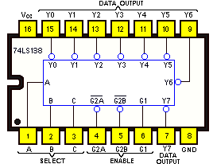
Block Decoders
Fortunately for us, devices exist, often in the form of a single chip, to make block decoding solutions easy for us, or we can use VHDL/Verilog for FPGA logic.
For example the 74138 is a simple 3 to 8 line decoder, giving us the ability to partition memory into 8 equal sized blocks.
A Pin-out and Truth Table for this device is illustrated below. It has 3 inputs (which could be fed to address lines), 8 outputs for 8 individual equal sized block select signals and 3 enable signal (for further refinement of address range).
INPUTS |  |  |  |  |  | OUTPUTS
G₁ | G_{2A} | G_{2B} | C | B | A | Y₀ | Y₁ | Y₂ | Y₃ | Y₄ | Y₅ | Y₆ | Y₇
0 | X | X | X | X | X | 1 | 1 | 1 | 1 | 1 | 1 | 1 | 1
X | 1 | X | X | X | X | 1 | 1 | 1 | 1 | 1 | 1 | 1 | 1
X | X | 1 | X | X | X | 1 | 1 | 1 | 1 | 1 | 1 | 1 | 1
1 | 0 | 0 | 0 | 0 | 0 | 0 | 1 | 1 | 1 | 1 | 1 | 1 | 1
1 | 0 | 0 | 0 | 0 | 1 | 1 | 0 | 1 | 1 | 1 | 1 | 1 | 1
1 | 0 | 0 | 0 | 1 | 0 | 1 | 1 | 0 | 1 | 1 | 1 | 1 | 1
1 | 0 | 0 | 0 | 1 | 1 | 1 | 1 | 1 | 0 | 1 | 1 | 1 | 1
1 | 0 | 0 | 1 | 0 | 0 | 1 | 1 | 1 | 1 | 0 | 1 | 1 | 1
1 | 0 | 0 | 1 | 0 | 1 | 1 | 1 | 1 | 1 | 1 | 0 | 1 | 1
1 | 0 | 0 | 1 | 1 | 0 | 1 | 1 | 1 | 1 | 1 | 1 | 0 | 1
1 | 0 | 0 | 1 | 1 | 1 | 1 | 1 | 1 | 1 | 1 | 1 | 1 | 0
2 active low plus 1 active high enable

Slide 10
Example Verilog code for a simple 3-8 decoder
module Decoder3to8Line ( CBA , G1 , G2 , G3 , Y7_Y0) ;
input G1 , G2 , G3 ; //3 enable inputs
input [ 2 : 0 ] CBA ; //3 bit input select bus
output reg [ 7 : 0 ] Y7_Y0 ;
always@( CBA , G1 , G2 , G3)
begin
if ( ( G1 == 1 ) && ( G2 == 0 ) && ( G3 == 0 ) ) begin // if device enabled
if ( CBA == 3'b000 ) Y7_Y0 = 8'b11111110 ; // if CBA = 000 set y0 to 0
else if ( CBA == 3'b001 ) Y7_Y0 = 8'b11111101 ; // else if CBA = 001 set y1 to 0
else if ( CBA == 3'b010 ) Y7_Y0 = 8'b11111011 ; // else if CBA = 010 set y2 to 0
else if ( CBA == 3'b011 ) Y7_Y0 = 8'b11110111 ; // else if CBA = 011 set y3 to 0
else if ( CBA == 3'b100 ) Y7_Y0 = 8'b11101111 ; // else if CBA = 100 set y4 to 0
else if ( CBA == 3'b101 ) Y7_Y0 = 8'b11011111 ; // else if CBA = 101 set y5 to 0
else if ( CBA == 3'b110 ) Y7_Y0 = 8'b10111111 ; // else if CBA = 110 set y6 to 0
else Y7_Y0 = 8'b01111111 ; // else if CBA = 111 set y7 to 0
end
else // if not enabled
Y7_Y0 = 8'b11111111 ; // set y7-y0 to 1’s
end
endmodule
Note: Y7-Y0 assigned a value for each path in the process above. Result: combinatorial logic with no storage/latches

Slide 11
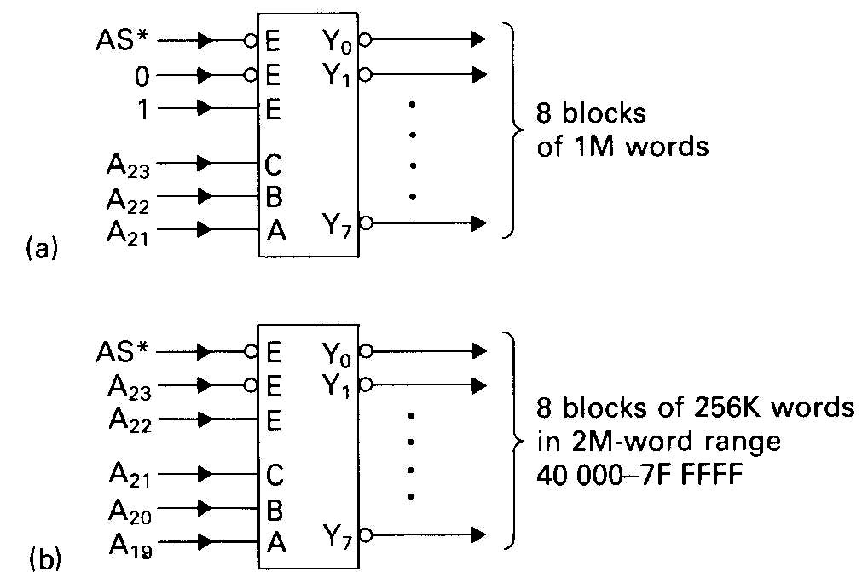
Simple Block decoder schemes using a 74138
Circuit a) below is used to decode the upper 3 address lines of the 68000 address bus to provide 8 blocks of 2M bytes, i.e. address blocks in the range
hex 00 0000 – 1F FFFF, 20 000 - 3F FFFF, …………., E0 000 - FF FFFF etc.
Circuit b) makes use of the enable lines to assist in the decoding a 4Mbyte block where A23 = 0,A22 = 1 into 8 blocks of 512k bytes.
The address range is 40 0000 – 47 FFFF, …………, 78 0000 – 7F FFFF
Active when {A23..A21} = {001}
74138
8 Blocks of 2M bytes in range
Y₀ range = [00 0000 – 1F FFFF]
Y₁ range = [20 0000 – 3F FFFF]
Y₂ range = [40 0000 – 5F FFFF]
Y₃ range = [60 0000 – 7F FFFF]
Y₄ range = [80 0000 – 9F FFFF]
Y₅ range = [A0 0000 – BF FFFF]
Y₆ range = [C0 0000 – DF FFFF]
Y₇ range = [E0 0000 – FF FFFF]
G2A
G2B
G1
Y₀
Y₁
Y₇
0
1
A₂₃
A₂₂
A₂₁
C
B
A
74138
G2A
G2B
G1
Y₀
Y₁
Y₇
8 Blocks of 512k bytes in range
Y₀ range = [40 0000 – 47 FFFF]
Y₁ range = [48 0000 – 4F FFFF]
Y₂ range = [50 0000 – 57 FFFF]
Y₃ range = [58 0000 – 5F FFFF]
Y₄ range = [60 0000 – 67 FFFF]
Y₅ range = [68 0000 – 6F FFFF]
Y₆ range = [70 0000 – 77 FFFF]
Y₇ range = [78 0000 – 7F FFFF]
A₂₃
A₂₂
A₂₁
A₂₀
A₁₉
C
B
A
Active when {A23..A19} = {01111}

Slide 12
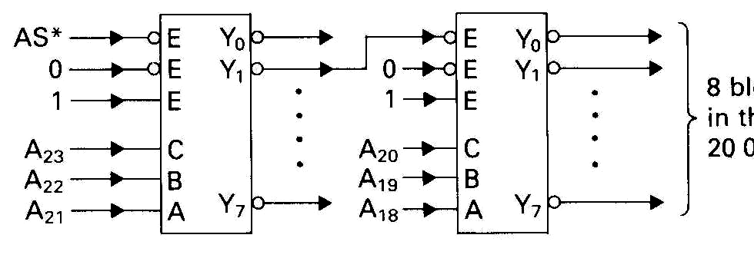
More Block decoder schemes using 74138
This scheme uses two cascaded 74138 devices to provide more refined block decoding. A23-A21 feed into the 1st device which provides block outputs of 2M bytes (as per previous slide).
The 2nd output (Y₁) from the 1st device, which is enabled for the address range
[20 0000-3F FFFF] is then used to enable a 2nd device fed with address lines A20-18.
This 2nd device decodes the address range 20 0000 - 3F FFFF into 8 smaller blocks of 256k words in the range 20 0000-23 FFFF, 24 0000-27 FFFF etc.
Active when {A23..A21} = {001}
8 Blocks of 2M bytes in range
Y₀ range = [00 0000 – 1F FFFF]
Y₁ range = [20 0000 – 3F FFFF]
Y₂ range = [40 0000 – 5F FFFF]
Y₃ range = [60 0000 – 7F FFFF]
Y₄ range = [80 0000 – 9F FFFF]
Y₅ range = [A0 0000 – BF FFFF]
Y₆ range = [C0 0000 – DF FFFF]
Y₇ range = [E0 0000 – FF FFFF]
G2A
G2B
G1
Y₀
Y₁
Y₇
G2A
G2B
G1
Y₀
Y₁
Y₇
0
1
A₂₃
A₂₂
A₂₁
0
1
C
B
A
A₂₀
A₁₉
A₁₈
C
B
A
8 Blocks of 256k bytes in range
Y₀ range = [20 0000 – 23 FFFF]
Y₁ range = [24 0000 – 27 FFFF]
Y₂ range = [28 0000 – 2B FFFF]
Y₃ range = [2C 0000 – 2F FFFF]
Y₄ range = [30 0000 – 33 FFFF]
Y₅ range = [34 0000 – 37 FFFF]
Y₆ range = [38 0000 – 3B FFFF]
Y₇ range = [3C 0000 – 3F FFFF]
74138
74138
Active when
{A23..A18} = {001 111}

Slide 13
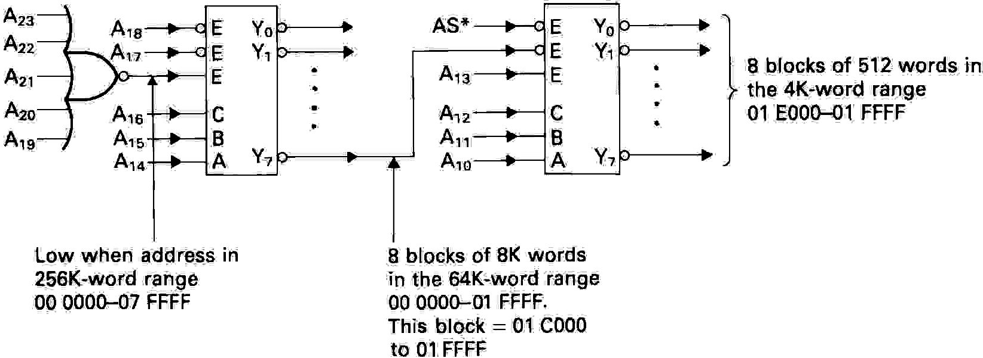
Sample Block decoder schemes using 74138 (cont…)
Finally, the circuit below, provides very fine grained address decoder resolution to provide 8 blocks of 1K byte in the address range [01 E000 – 01 FFFF]
Such a scheme might be employed to select 1 of 8 possible small I/O devices within the system and limit their address space to a very small part of the overall memory map of the system.
Active when
{A23..A14} = {0000000000}
Active when
{A23..A10} = {0000000111010}
74138
74138
A₂₃
A₂₂
A₂₁
A₂₀
A₁₉
G2A
G2B
G1
Y₀
Y₁
Y₇
0
G2A
G2B
G1
Y₀
Y₁
Y₇
A₁₈
A₁₇
8 blocks of 1k byte in the 8K byte range
01 E000 – 01 FFFF
A₁₃
A₁₂
A₁₁
A₁₀
A₁₆
A₁₅
A₁₄
C
B
A
C
B
A
High when address in range [00 0000 – 07 FFFF]
Decoded into 8 blocks of 16k bytes in the 128k byte range
00 0000 – 01 FFFF.
This block = 01 C000 - 01 FFFF
high

Slide 14
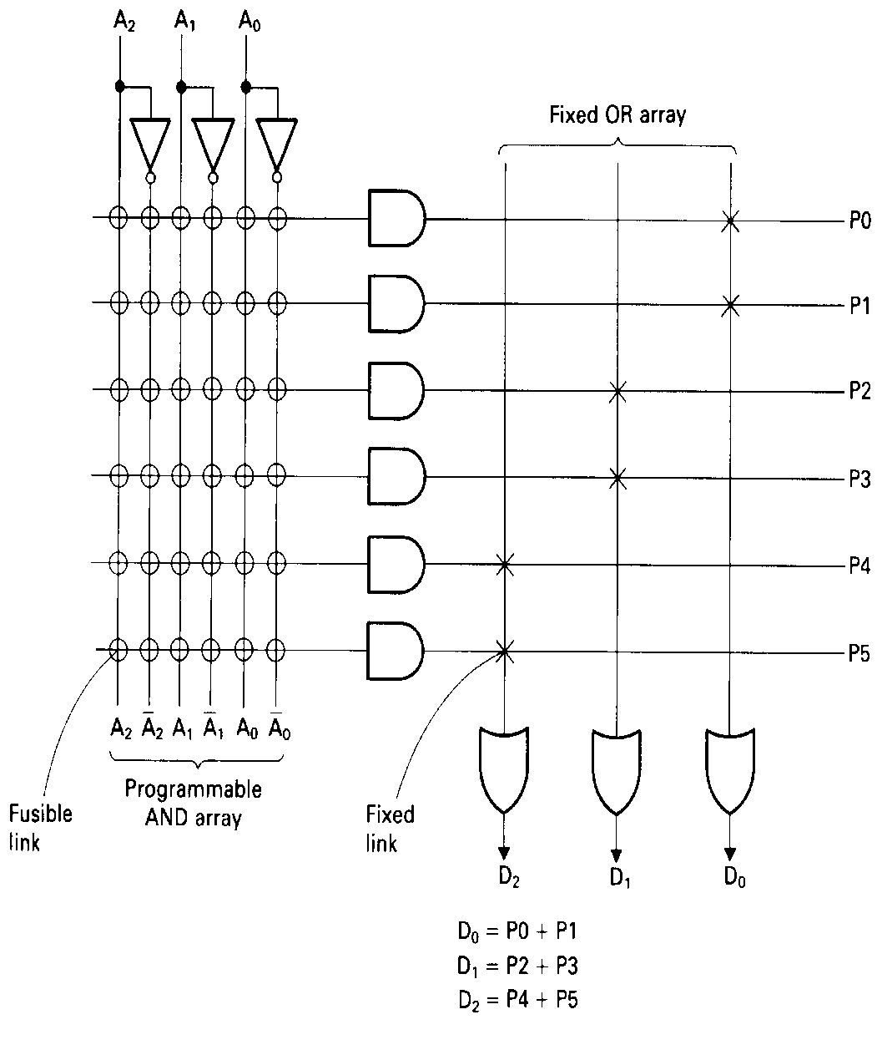
Address Decoding Using PAL logic
Simple programmable logic has an architecture ideally suited to implementing a sum-of-products (SOP) expression.
Any decoder can be expressed in SOP form and implement a decoder provided it has enough inputs and outputs
The illustration here demonstrates the principle with a simplified section of a device.
This device has 3 input terms, [a0,a1,a2] which are available in their normal and inverted forms.
The diagram illustrates a device with 6 product terms, i.e. 6 AND gates connected via ‘fuses’ to any combination of the 3 input terms, thus each AND gate has 6 inputs and 6 fuses.
Designing address decoders with PALs involves generating the Boolean logic equations from the address table and ‘generating a fuse map’ (JEDEC file) which can be downloaded to a Prom programmer to ‘blow’ the device.
3 Input Terms
6 Product Terms
Programmable OR terms
3 Output Terms used as chip selects in our address decoder

Slide 15
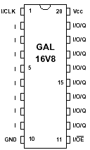
GAL Example: GAL16V8
The Pin out for the Lattice GAL16V8 is shown below:
The pins can be grouped as follows:
Pins | Signal Names
1 | Clock input (not used for decoding)
2-9 | Inputs: Address line from CPU
10 | Ground (0V)
11 | Output Enable
12-19 | Outputs: Chips selects
20 | Power (5V)
The GAL16V8 is a fast erasable PAL with a 3.5nsec decode time and 100msec erase time.

Slide 16
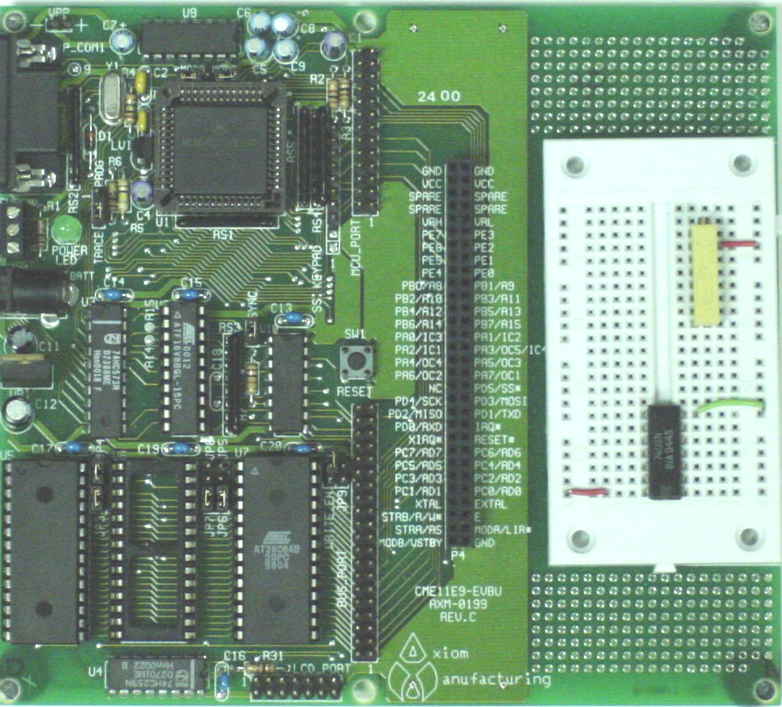
Axiom 68HC11 - Microcomputer System Board
Keyboard Interface
Mode Select Jumpers:
MODA and MODB
MCU Port: Address + Data bus etc
IO Interface Port
RS232 Level Translator
8MHz Crystal
Prototyping Area
Serial Port
6811
TRACE/PROG Jumper
PWR Terminal Block
Power Jack
Reset Button
AD0-7 Multiplexer
Primary Memory Map Logic
(GAL16V8)
Secondary Peripheral Chip Select Logic
74138 3-8 line decoder
U5
(32K battery backed SRAM)
U6
(32K SRAM not all accessible)
CPU BUS Port
LCD Port and Control Logic
U7
(8K EEPROM

